Slide 1
Database for a UAV company
CSC3170
Group Project
REPORT
Group members: Yihan Li, Zeyu Li, Yuxuan Liu, Yutao Qiu

Slide 2
Introduction
01

Slide 3
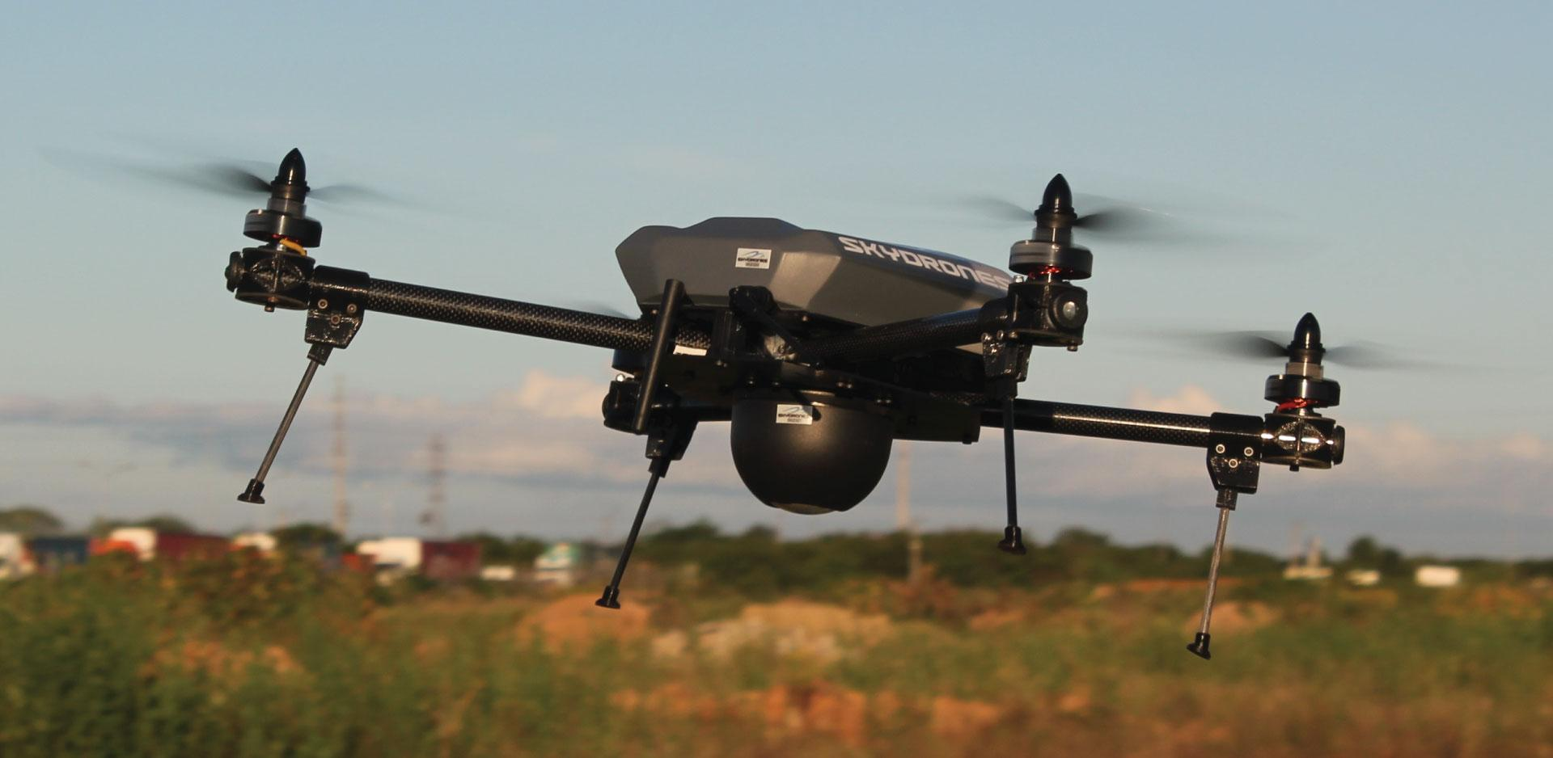
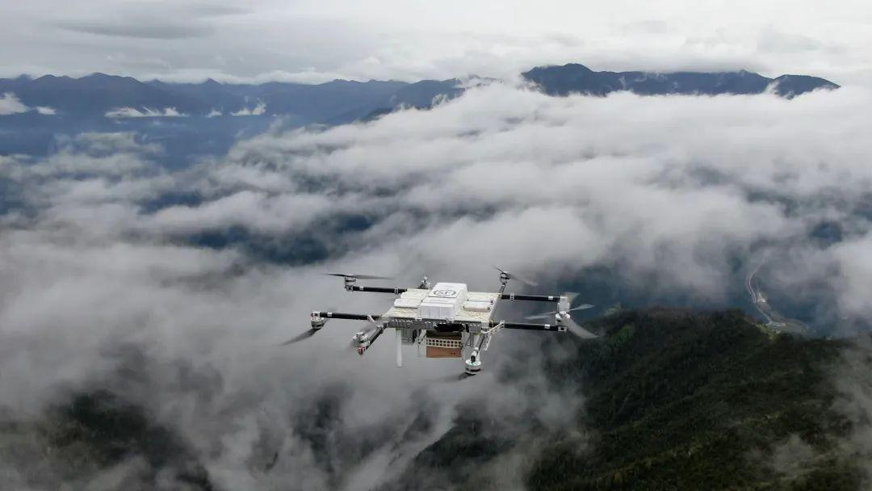
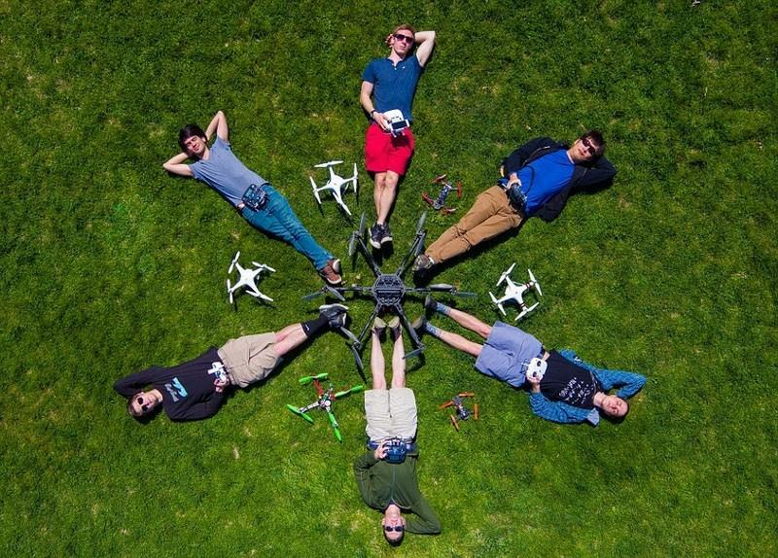

Slide 4

The DJI company
Manufacturing
Sales
Product
Maintenance

Slide 5
Assumptions
1.
A certain kind of component can be used as the component of multiple kinds of drones.
2.
Each time a customer can buy multiple drones and components in a sale order through only one staff.
3.
Each time a customer can send a drone to repair to a store in a repair order through only one staff.
4.
The repair sections are only located within the stores.
5.
One repair order can only guarantee the repairing of one product.
6.
One employee can only provide service in a fixed post.
7.
Each customer have only one address to receive the goods.
8.
There are only three kinds of staff: sales staff, repair staff and factory staff.
9.
There are only four kinds of components: batteries, controllers, propellers and charging hubs.

Slide 6
ERD And Relational Schemas
02

Slide 7


E-R Diagram Design
Products
Sales and Repair
Staff and Store
Product
(Drone
Battery
Controller
Propeller
Charging Hub)
.
Customer
Order
Order Item
Repair
Store
Staff
(Sale, Repair, Factory Staff)
Factory
Factory Product

Slide 8
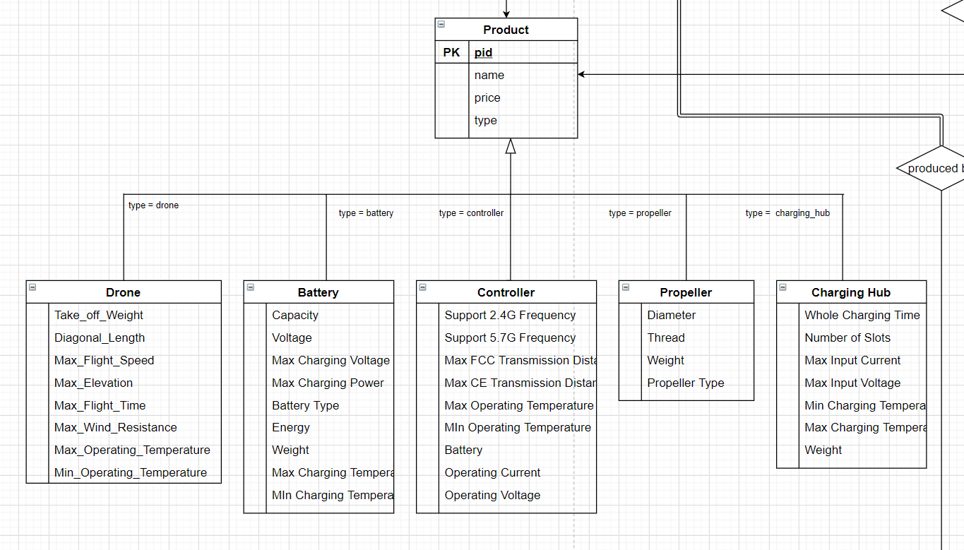
E-R Diagram Design
Products
Product
(Drone
Battery
Controller
Propeller
Charging Hub)
.

Slide 9
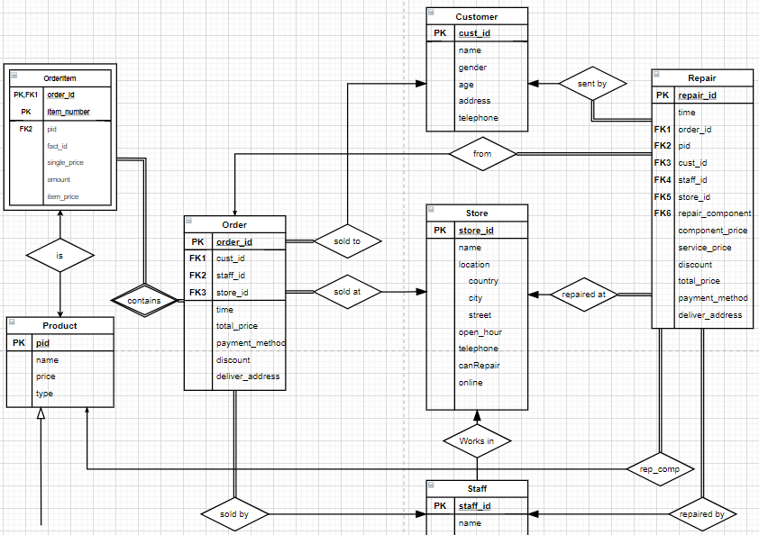
E-R Diagram Design
Sales and Repair
Customer
Order
Order Item
Repair

Slide 10
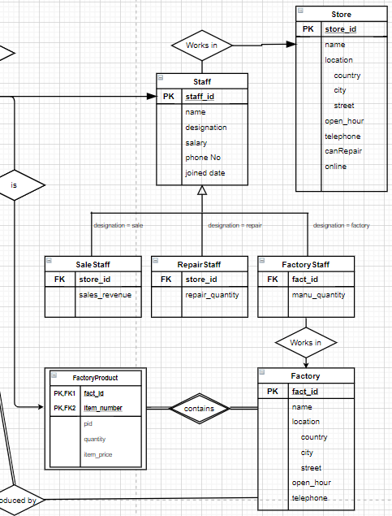
E-R Diagram Design
Staff and Store
Store
Staff
(Sale, Repair, Factory Staff)
Factory
Factory Product

Slide 11
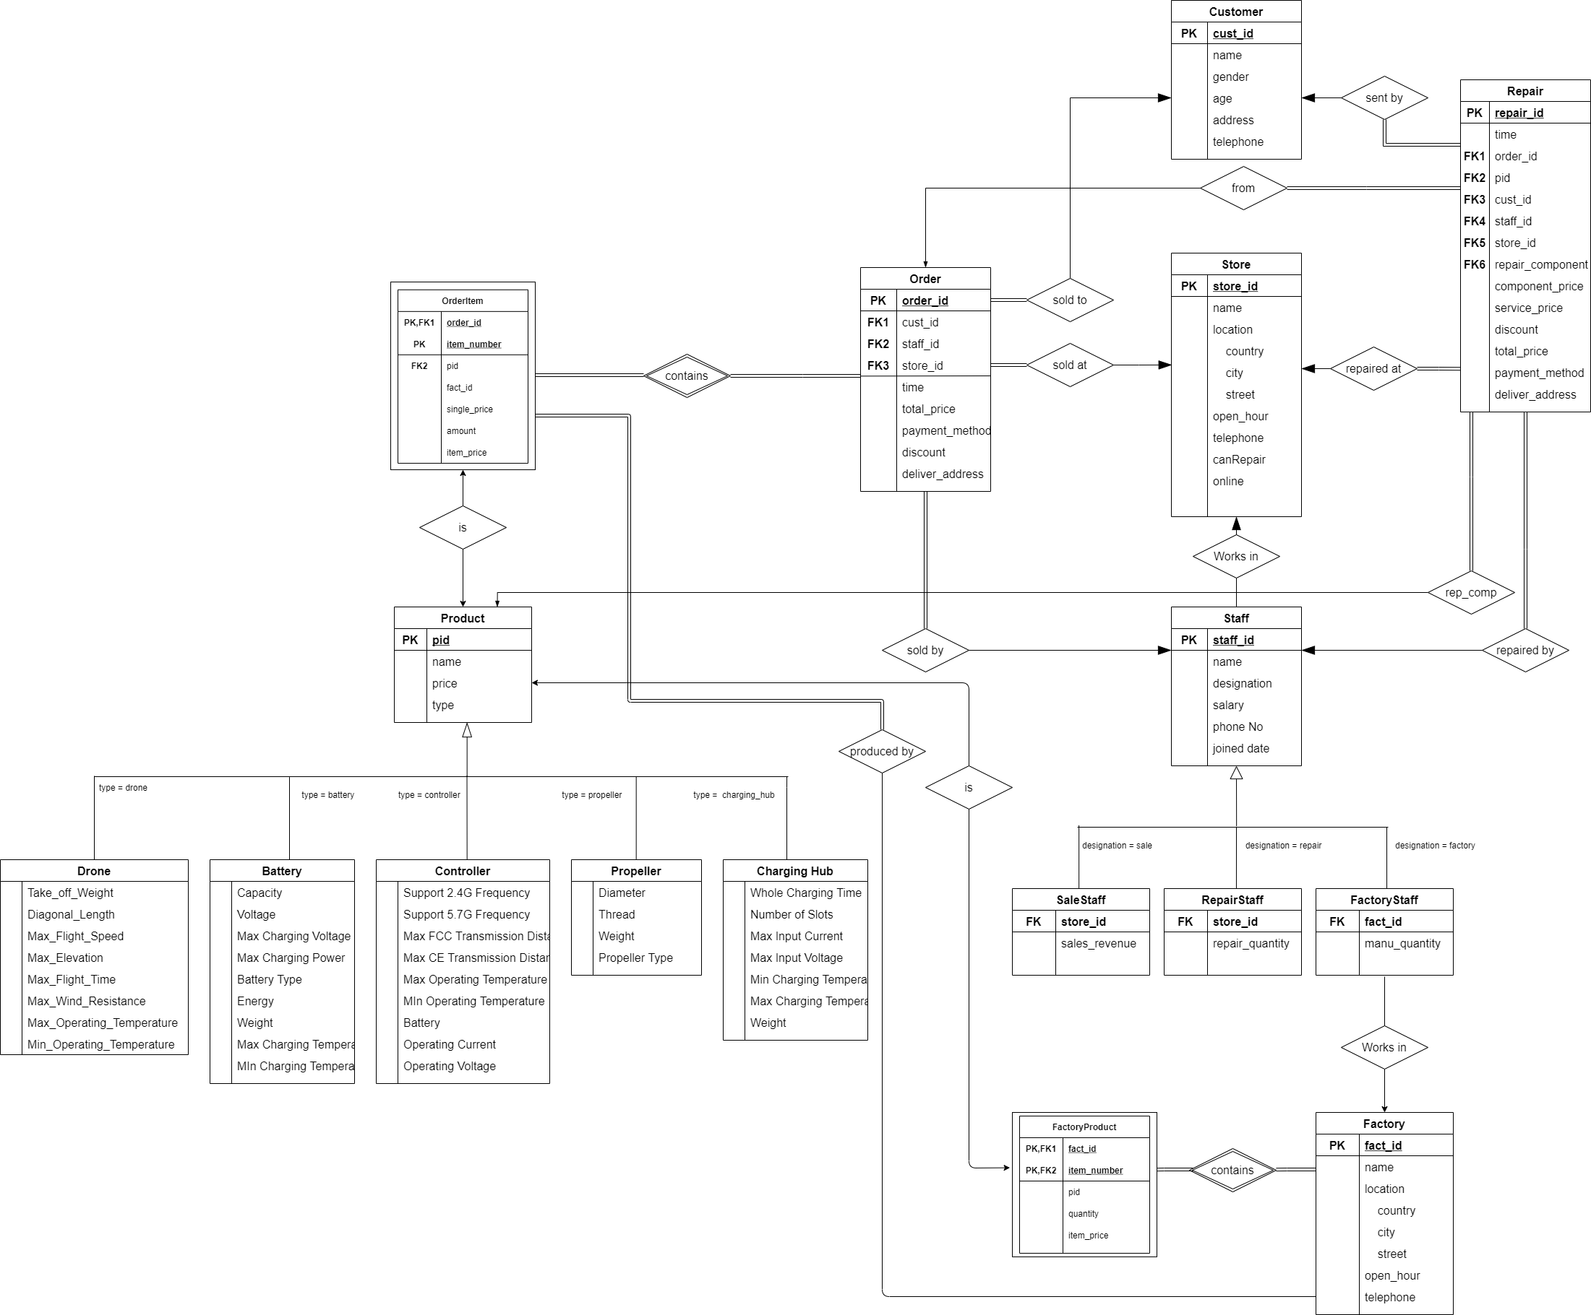
ERD Overview
Sales and repair
Product
Staff and Store

Slide 12
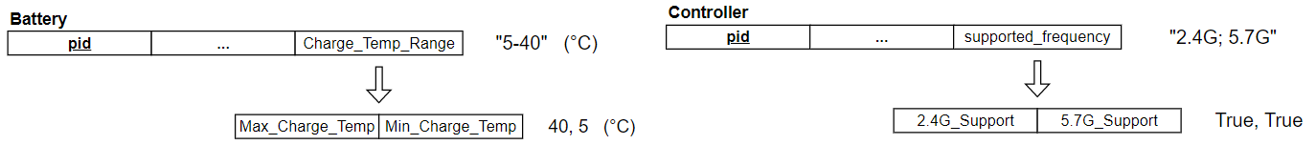
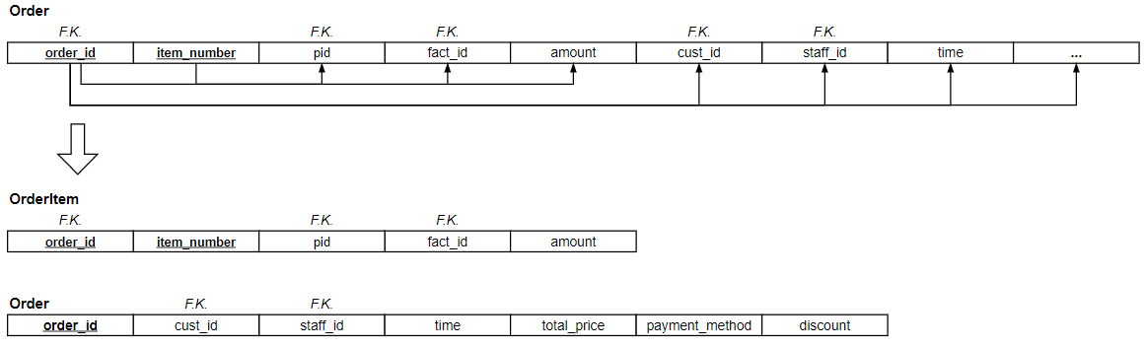
Normalization
Atomic Domine
1NF
Fully Functional Dependency
2NF
3NF

Slide 13
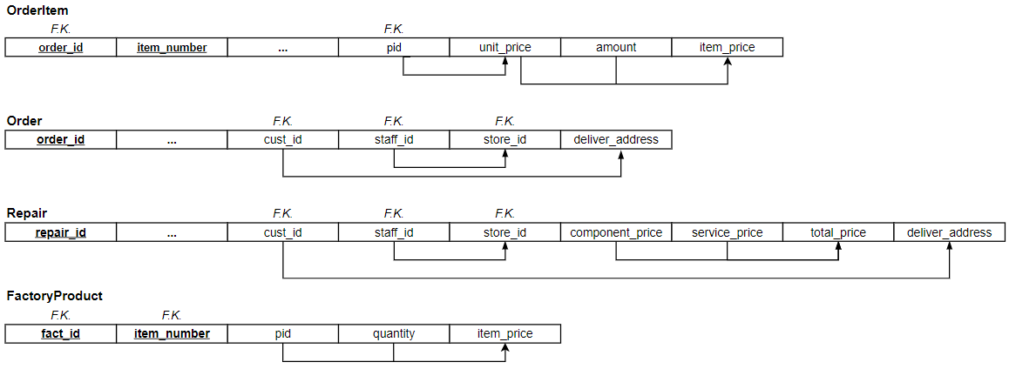
Normalization
Transitive Dependency on PK
3NF

Slide 14
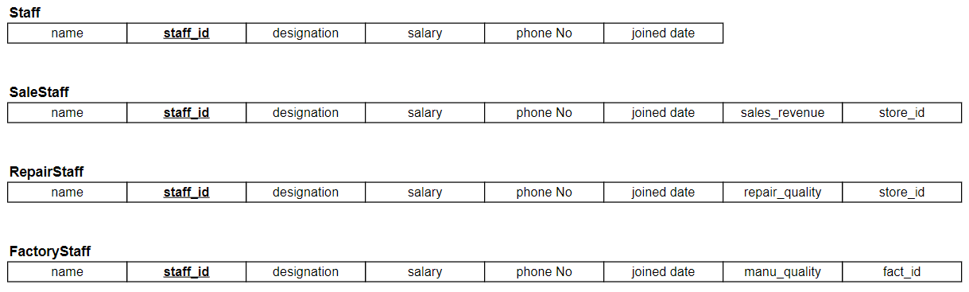
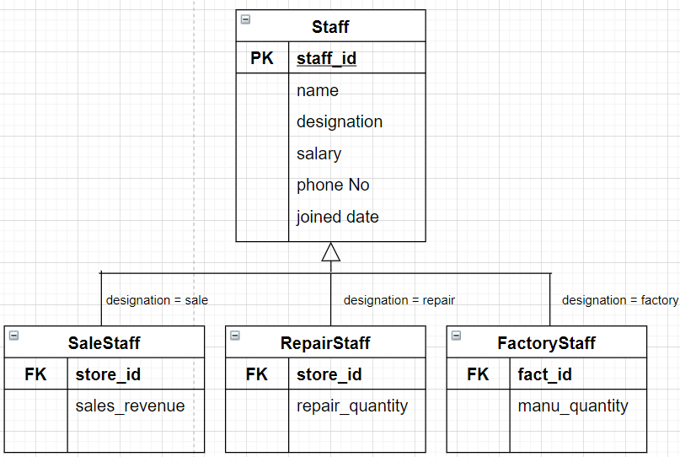
Specialization Design
0.
1.
2.
3.

Slide 15
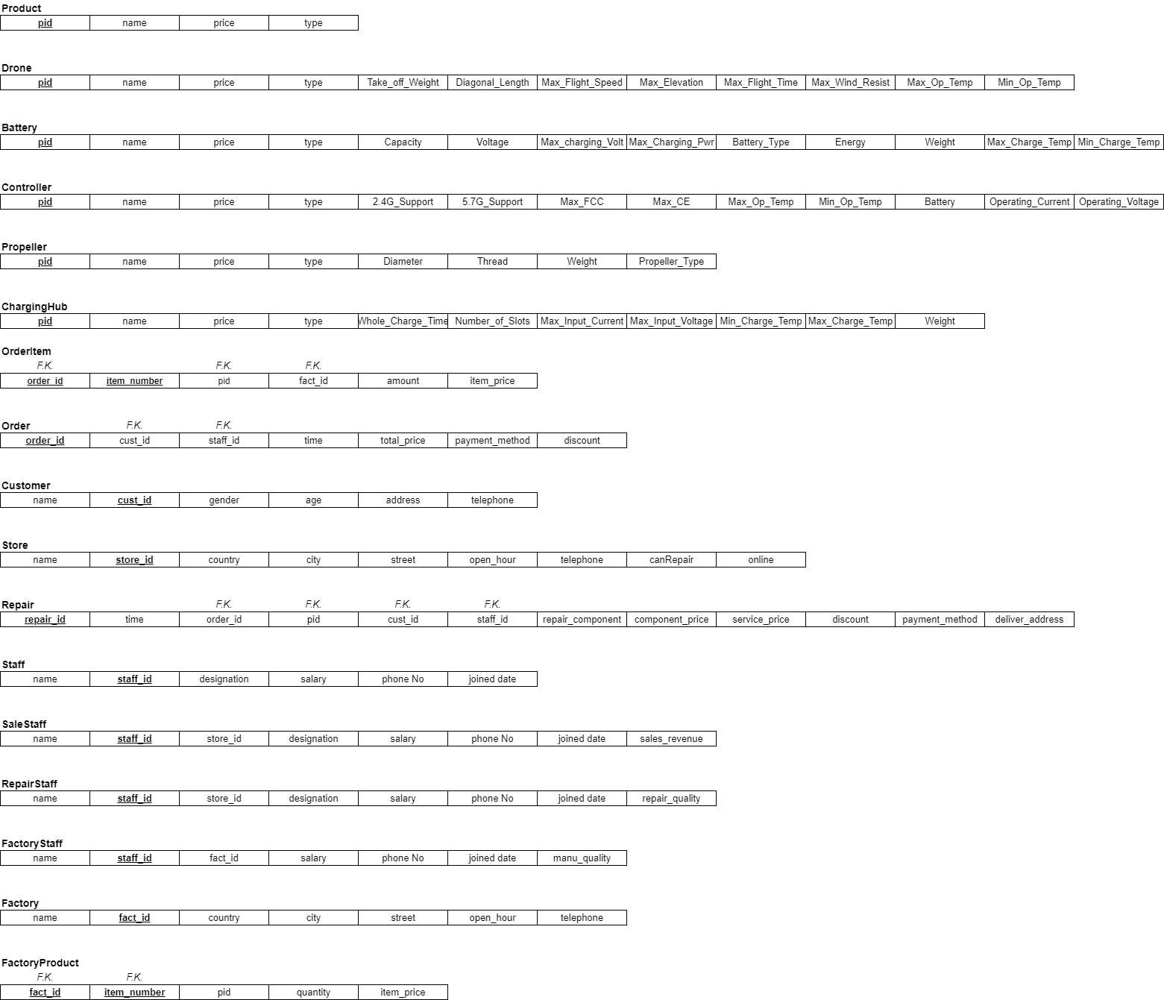
Relational Schema Overview

Slide 16
Data and Query
03

Slide 17
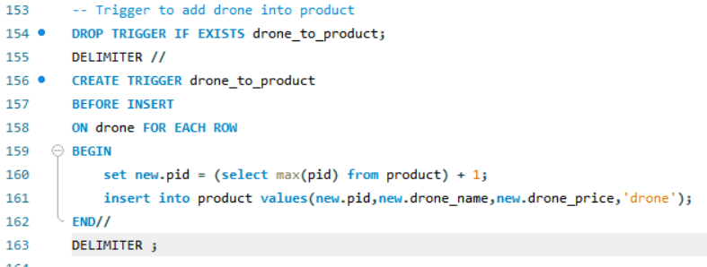
Data Insertion
Real data retrieved from
DJI website
Create Tables
Import Real Data
Generate Random
Data
Ready for Query
Random data generated by Python script
Use trigger to keep data id consistent

Slide 18
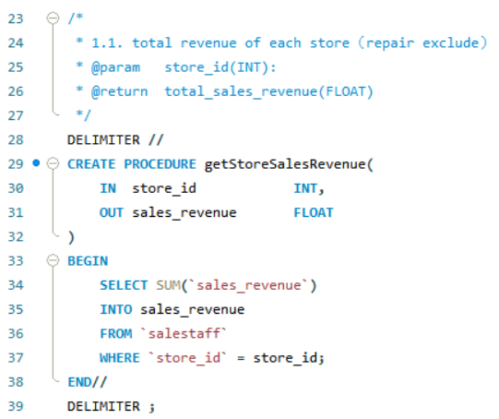
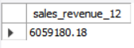
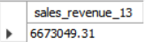
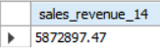
Query Test
Procedure
1.
Query sale revenues of each store

Slide 19
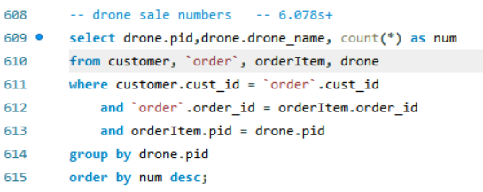
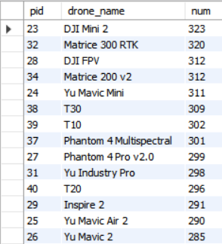
Query Test
2.
Query drones with the largest sales

Slide 20
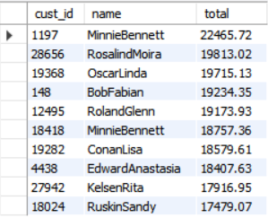
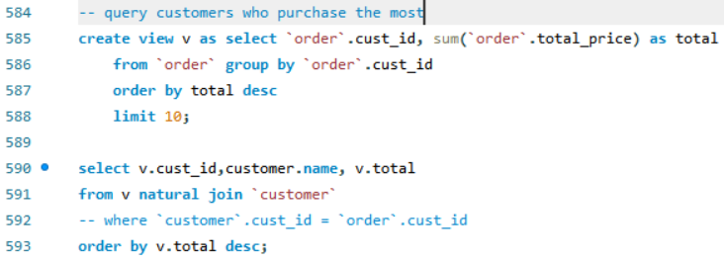
Query Test
3.
Query customers who purchase the most
View: add up all orders

Slide 21
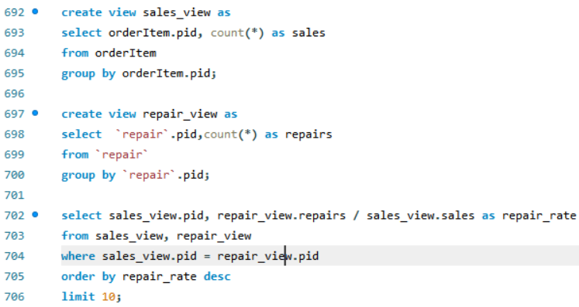
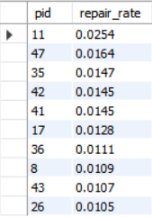
Query Test
4.
Query the products with the highest repair rate
Repair Rate = #repair orders / #purchase orders

Slide 22
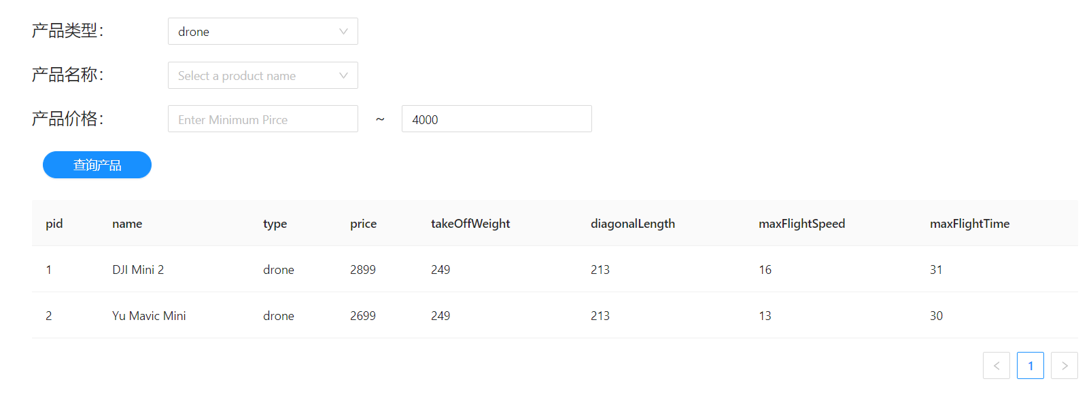
Query GUI

Slide 23
Indexing (BTree or Hash?)
04
Presenter: Liu Yuxuan (118010200)

Slide 24
Something About Index
1. Why we use index?
-- Speed up database queries when the amount of data gets large
2. Use on what kind of attributes?
Primary Key
Attributes that are used frequently (Foreign Keys, name, price)
More indices do not always mean better performance!
3. Which kind of index should we use?
Index (B Tree / B+ Tree)
Hash (Hash Tables)

Slide 25
Which one is better?
Depends on the data field you create index on
95%
InnoDB Engine only supports user defined Btree index (B+ Tree)
Btree index is more general and stable, can be used anywhere.
Hash index is fast but not good at range selection and composite indices.
Data Structure Determines Performance and Feature!
Case 1: item_price
Case 2: Orderitems PK
Other PK and FK
Involves range selection,
Use Btree Index
Composite PK,
Use Btree Index
All of them are ID, no range selection, no composite,
Hash index is better

Slide 26
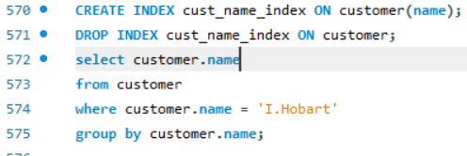
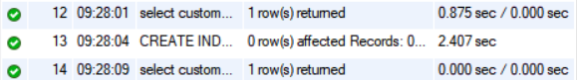
Efficiency Analysis
Case 1
Speed up 40 – 50 times
Case 2
Many many times

